Slide 1
SARS-CoV-2 sequence submission & annotation
The National Center for Biotechnology Information (NCBI)
Eric Nawrocki, Linda Yankie & Yuriy Skripchenko
Oct. 21st 2020

Slide 2
Overview
Introduce helpful tool for SARS-CoV-2 annotation: VADR!
Share submission trends & tips for fast, error-free submission
Continue dialogue on NCBI submission with this community

Slide 3
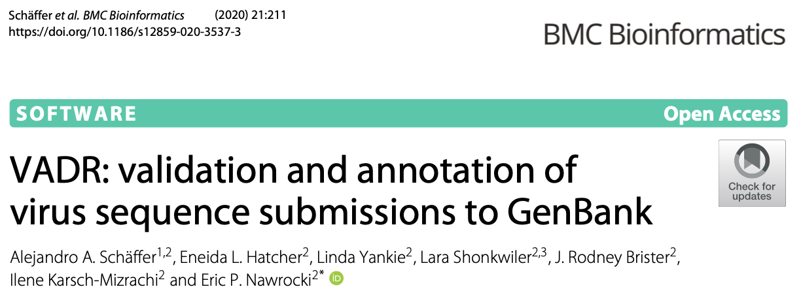
VADR: Viral Annotation DefineR
General tool for reference-based annotation of viral sequences
Aligns sequences globally with respect to a RefSeq or profile
Originally designed for dengue virus and norovirus but used for SARS-CoV-2 since March 2020

Slide 4
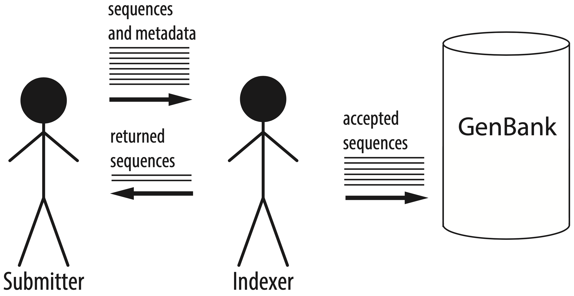
GenBank indexers handle incoming sequence submissions

Slide 5
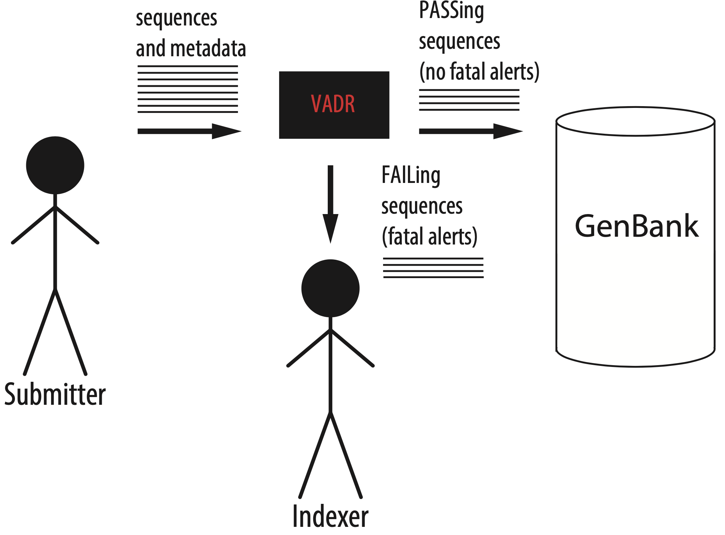
VADR assists GenBank indexers: Each sequence PASSes or FAILs

Slide 6
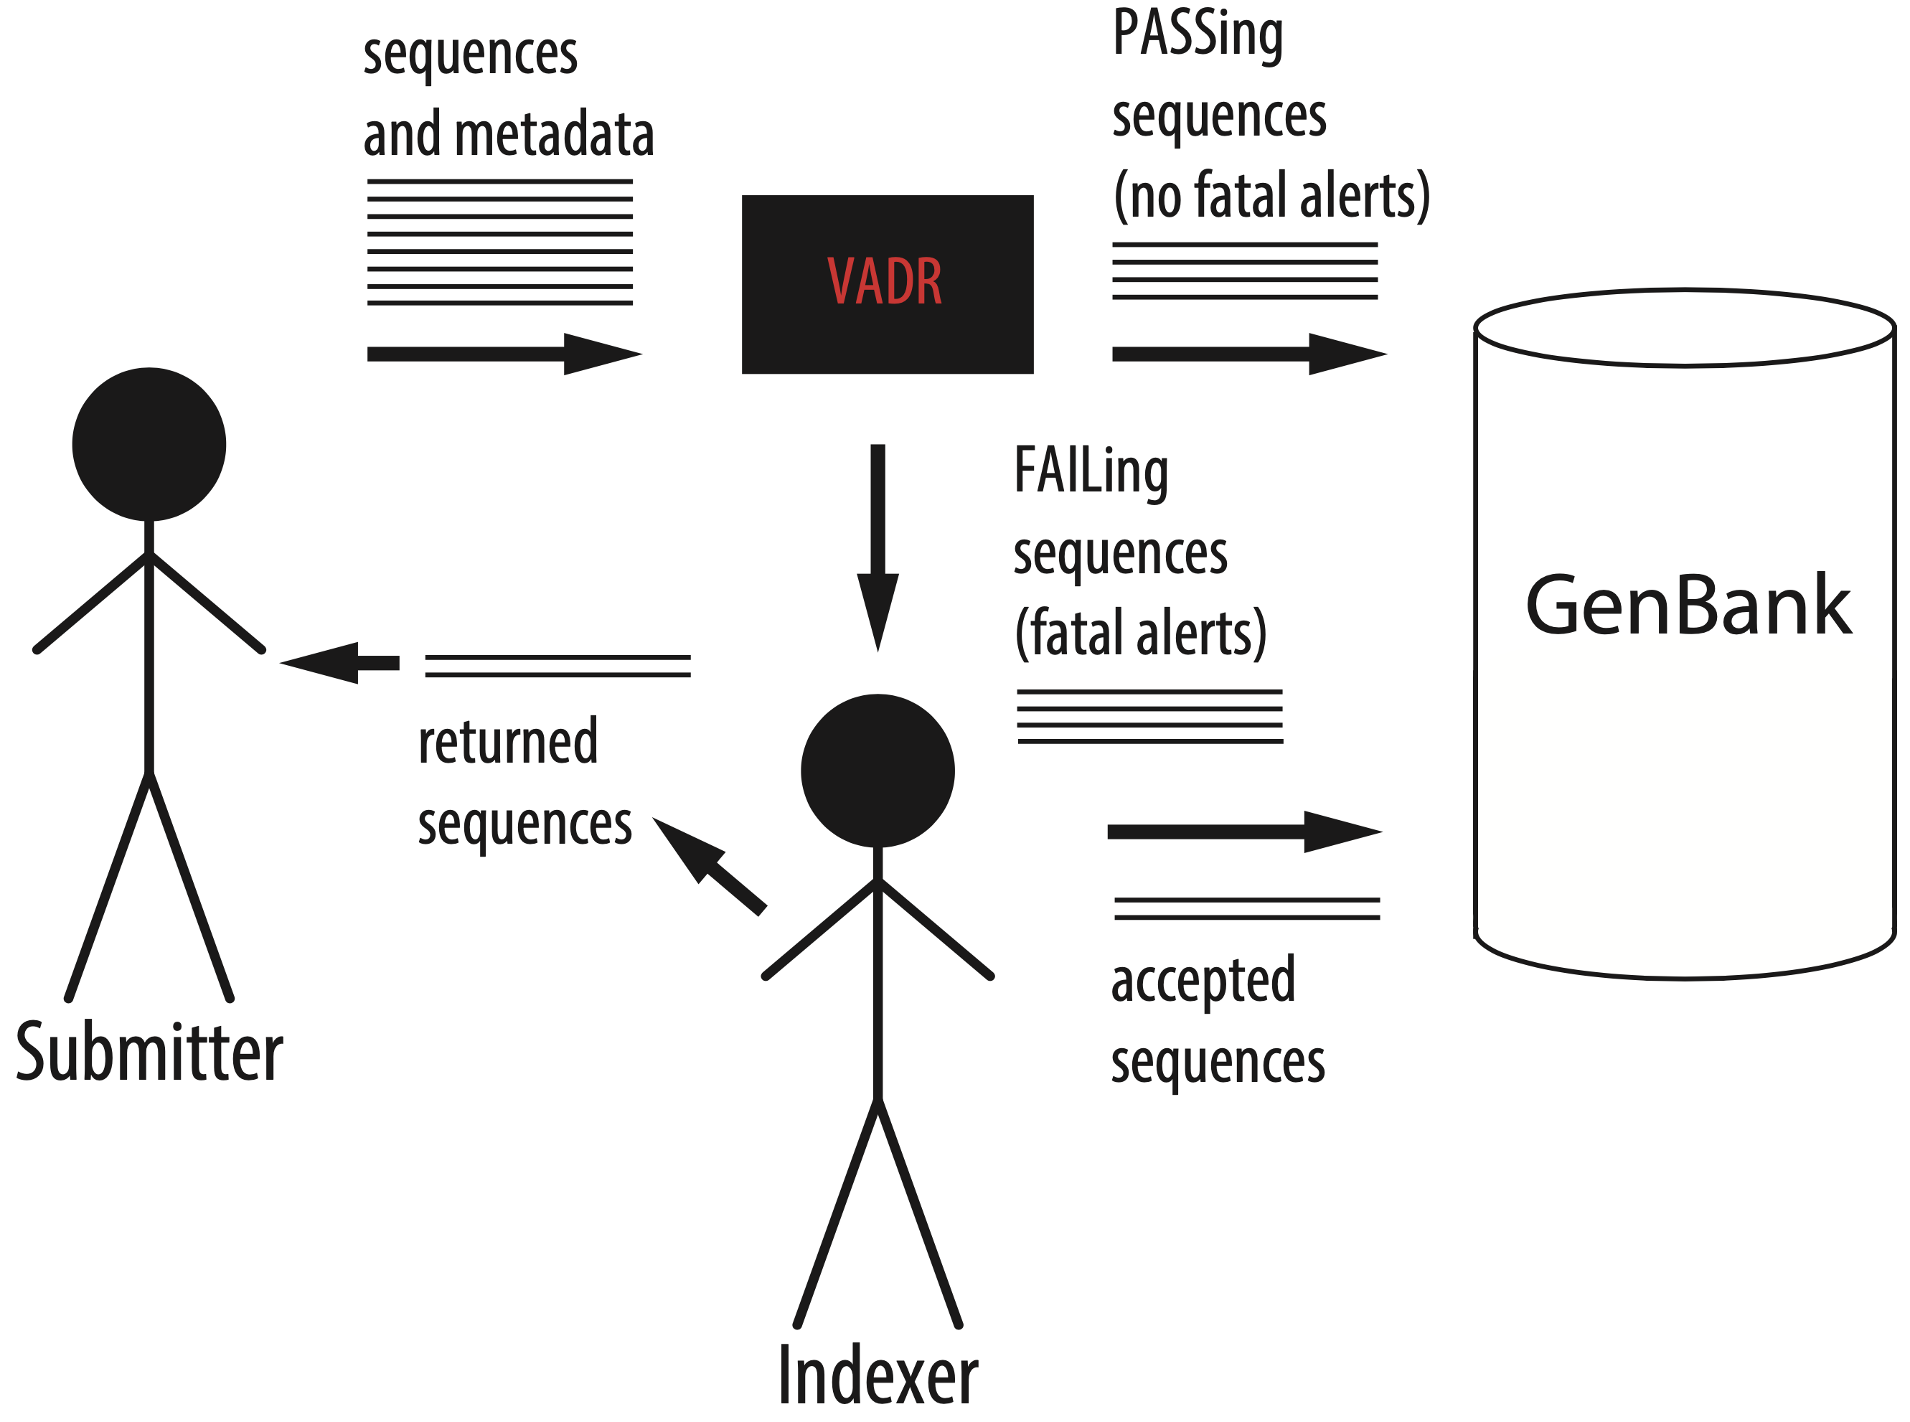
Indexers decide fate of FAILed sequences

Slide 7
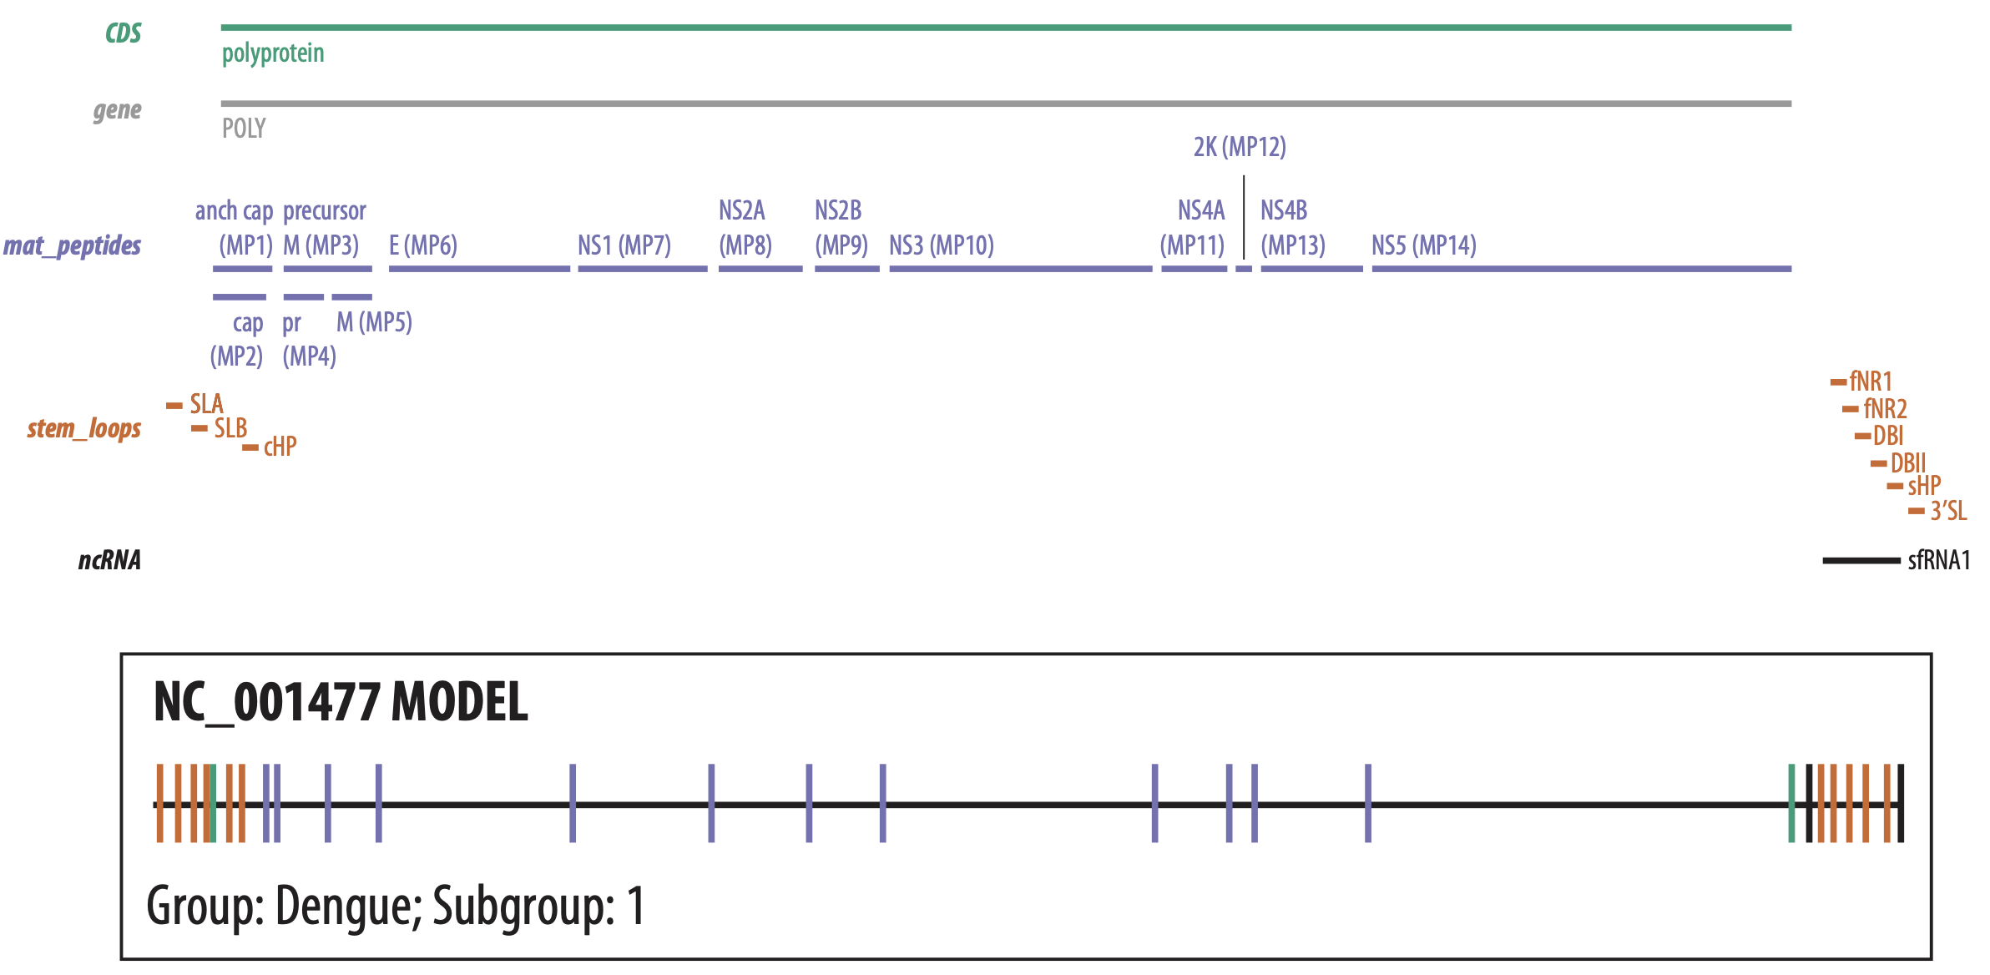
VADR builds homology model (covariance model) of a RefSeq & stores feature info

Slide 8
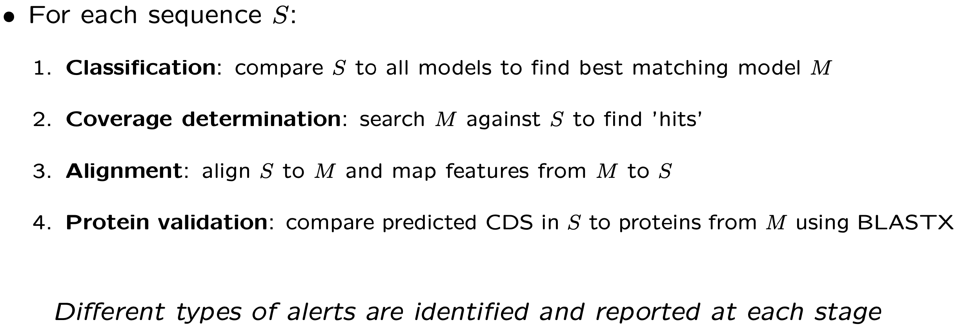
VADR annotates each sequence with features from its best matching model

Slide 9
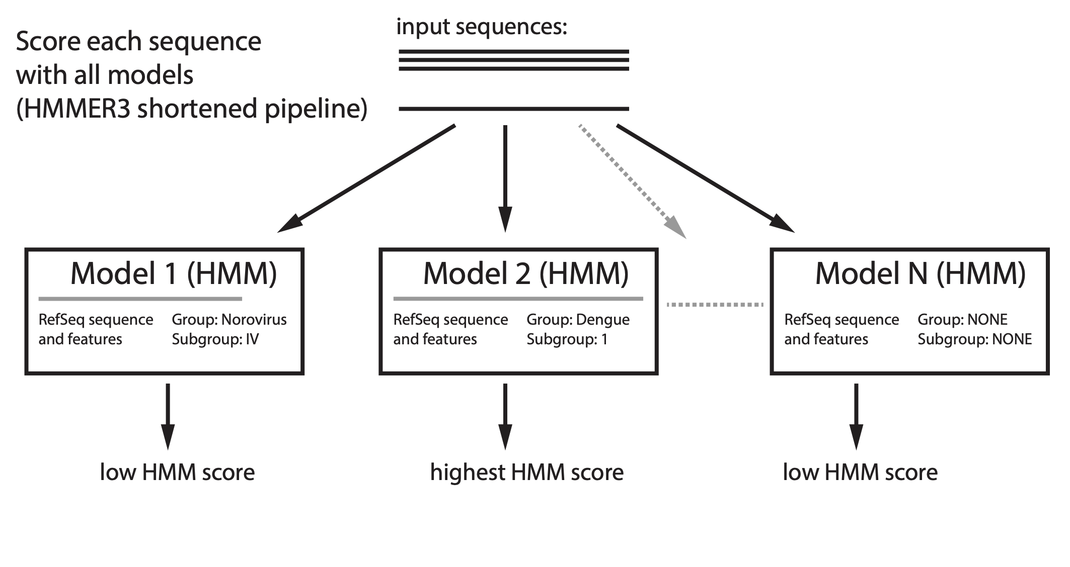
Stage 1: Classification

Slide 10
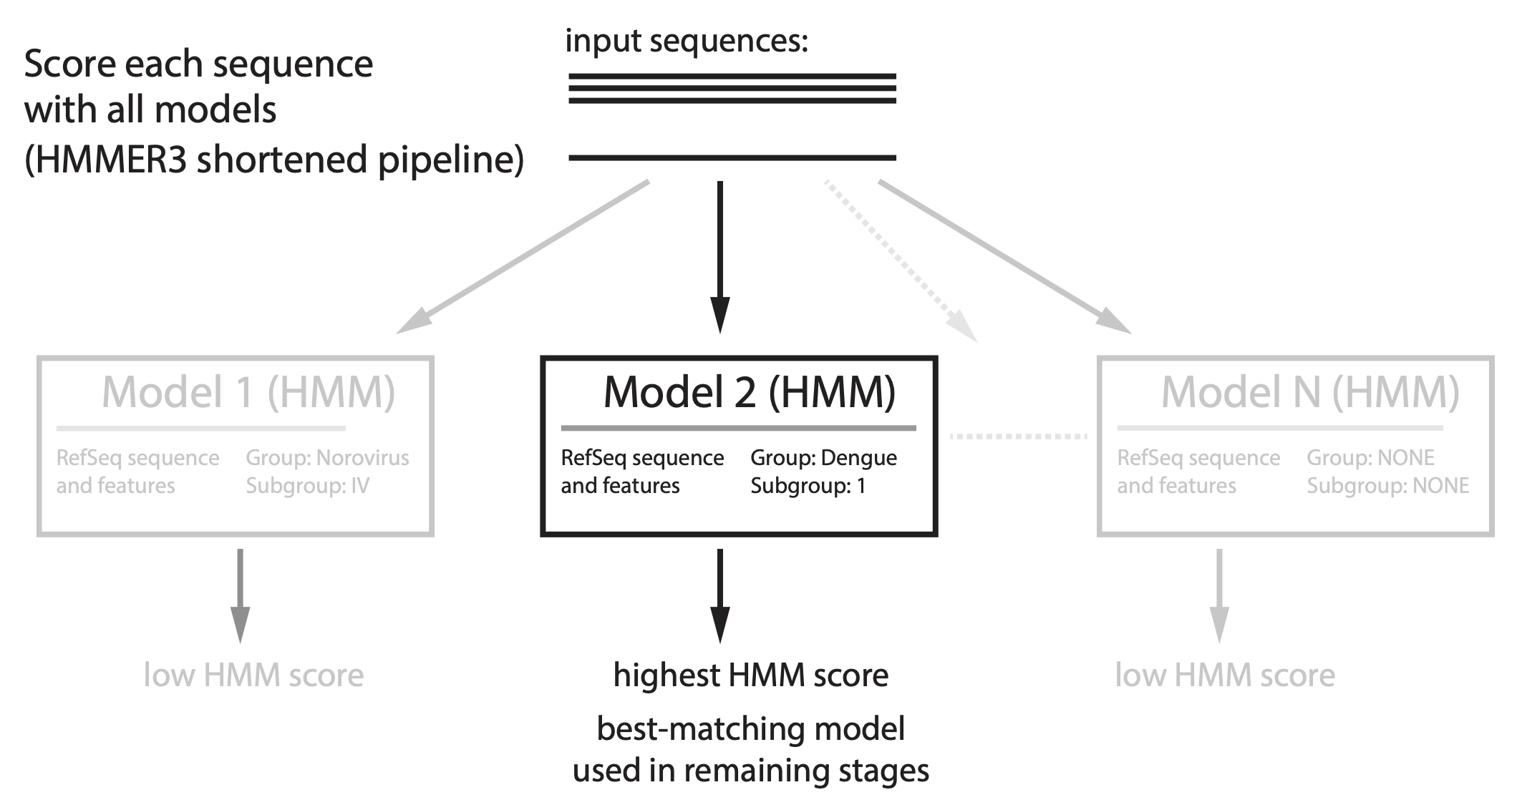
Stage 1: Classification

Slide 11
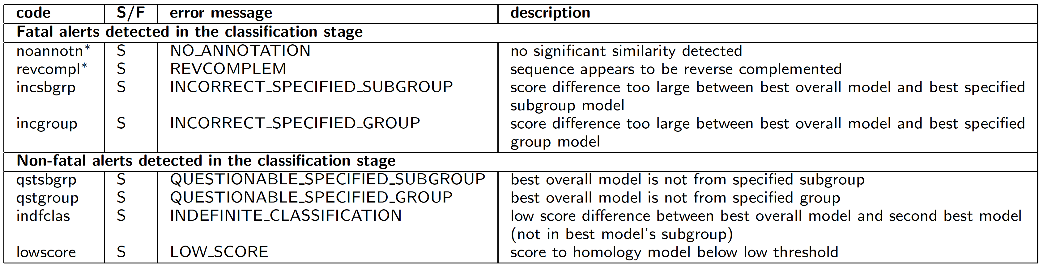
Alerts reported in classification stage

Slide 12
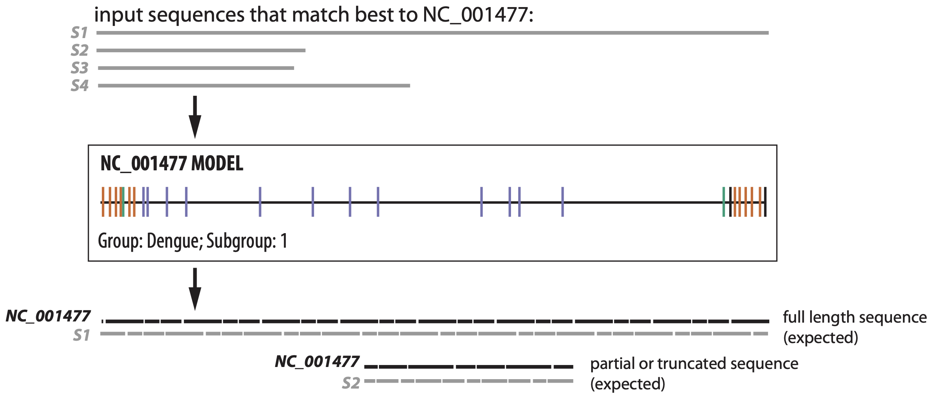
Stage 2: Coverage determination
Search each sequence with best-matching model (HMMER3 full pipeline)

Slide 13
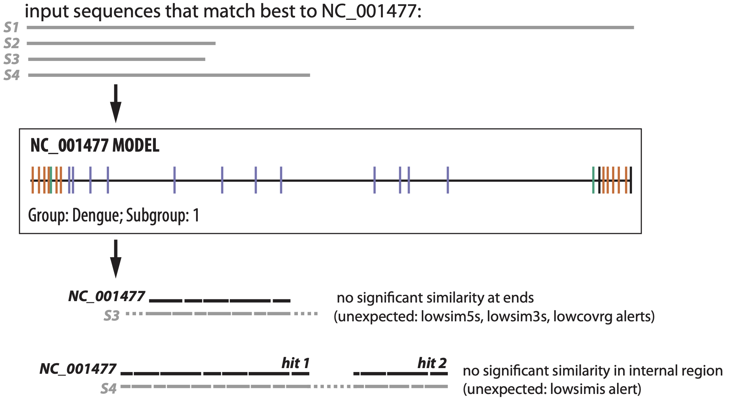
Stage 2: Coverage determination
Search each sequence with best-matching model (HMMER3 full pipeline)

Slide 14
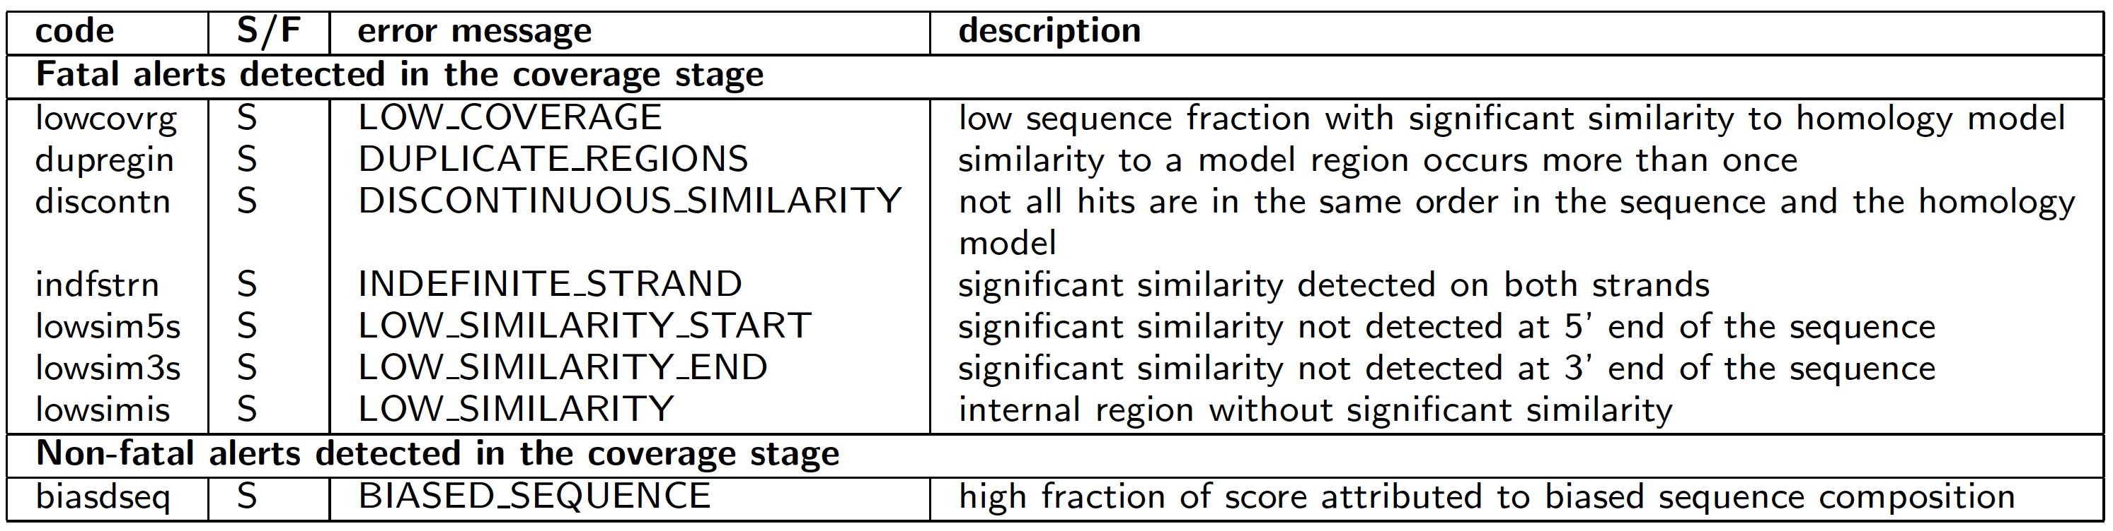
Alerts reported in coverage determination stage

Slide 15
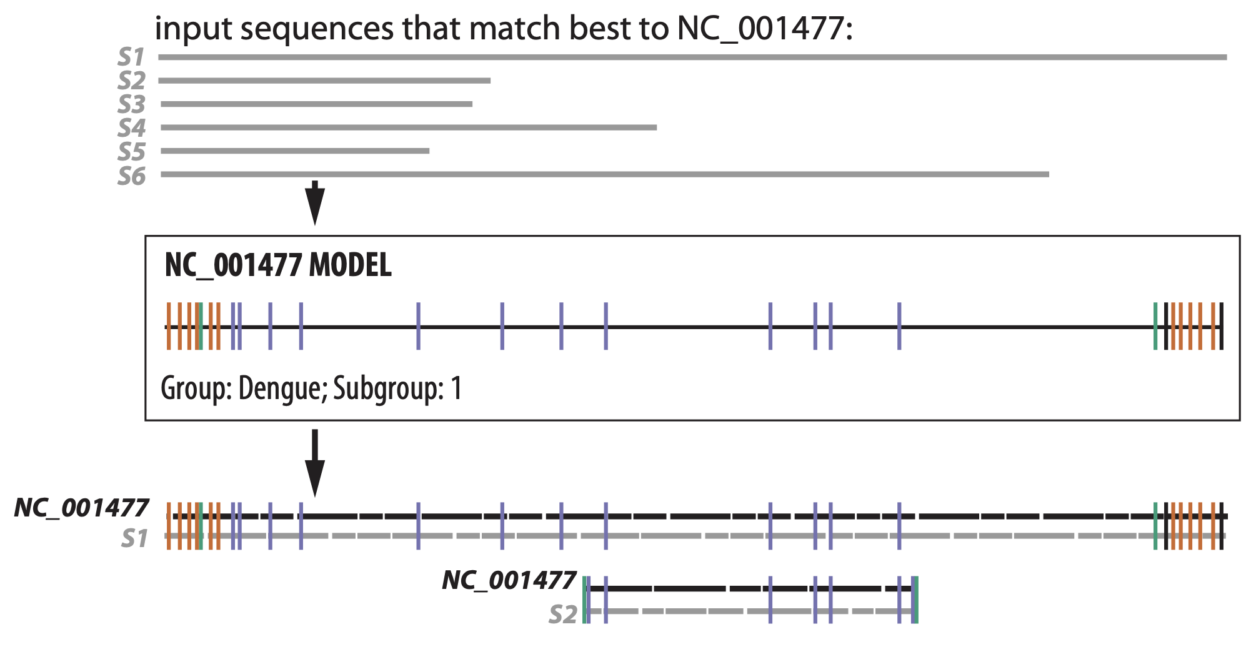
Stage 3: Alignment & feature mapping
Align each sequence to its best-matching model (Infernal's cmalign)

Slide 16
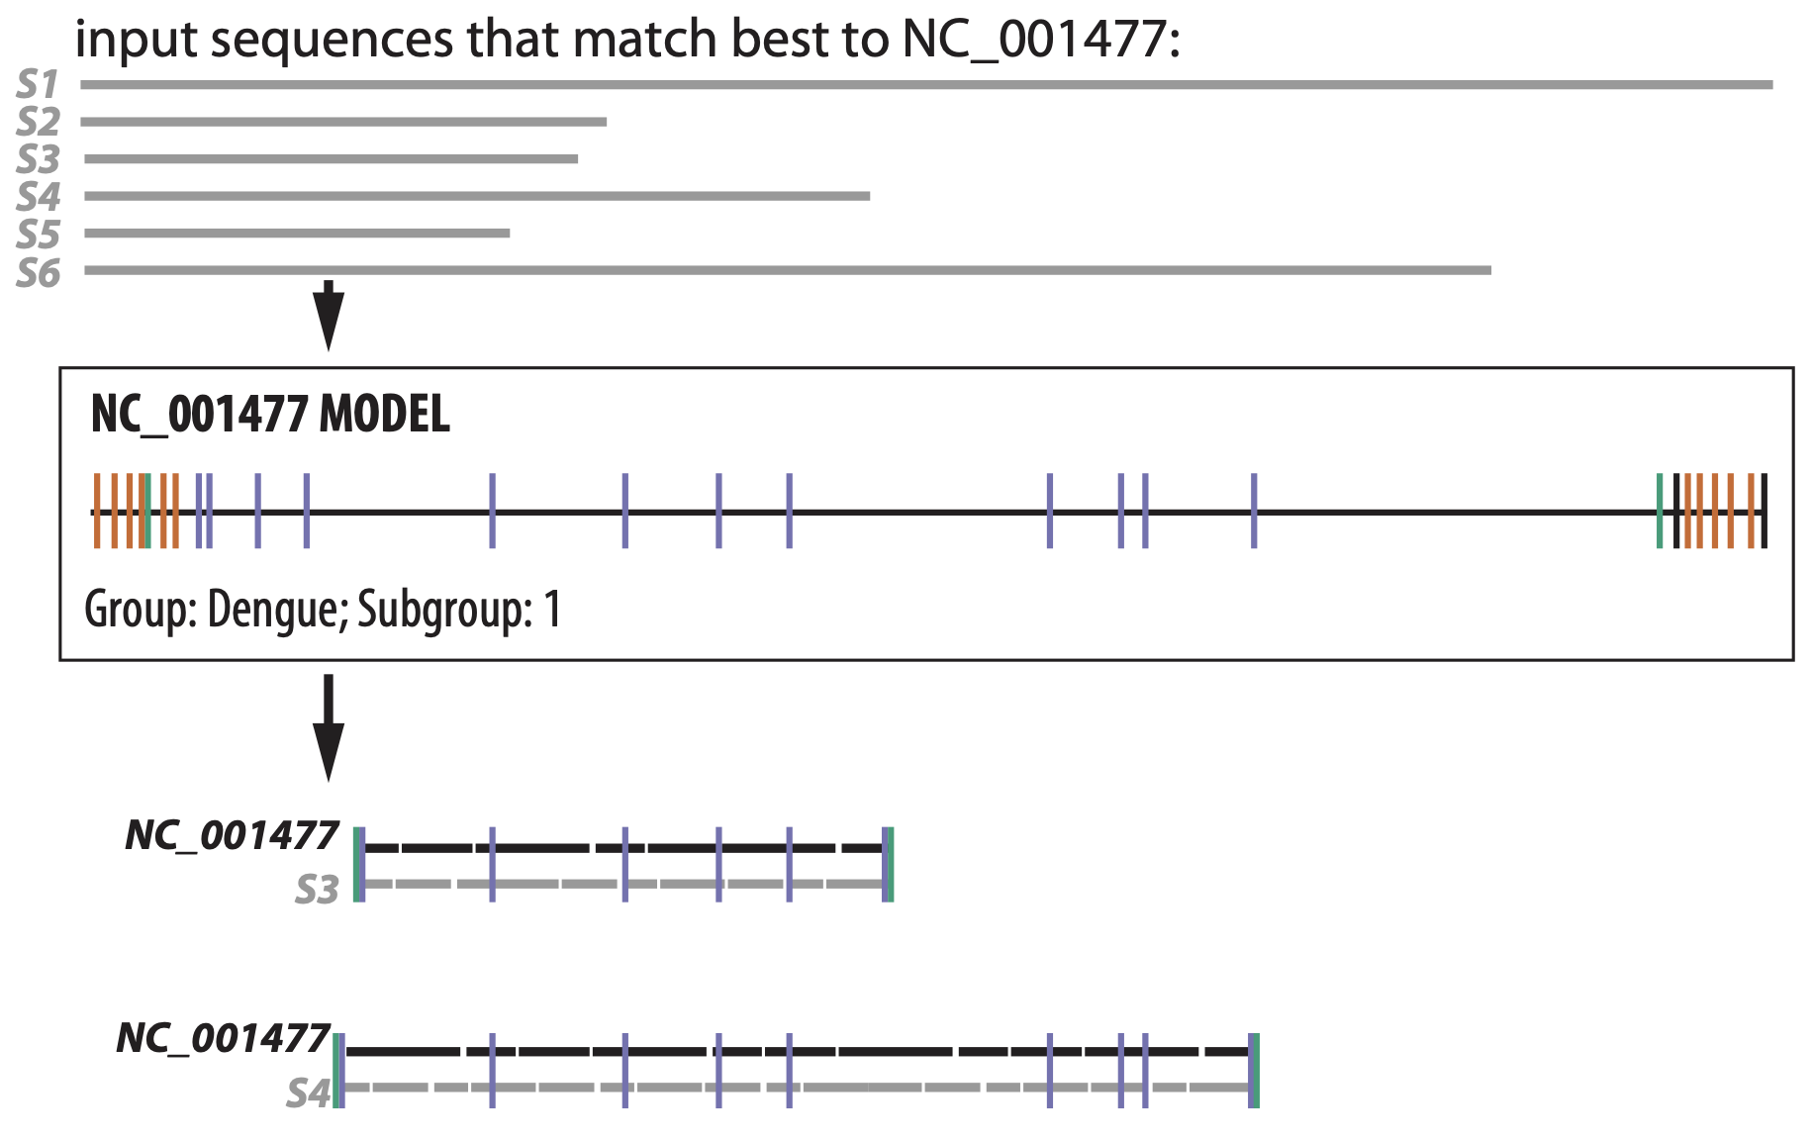
Stage 3: Alignment & feature mapping
Problems caught in coverage determination stage could be missed in alignment stage

Slide 17
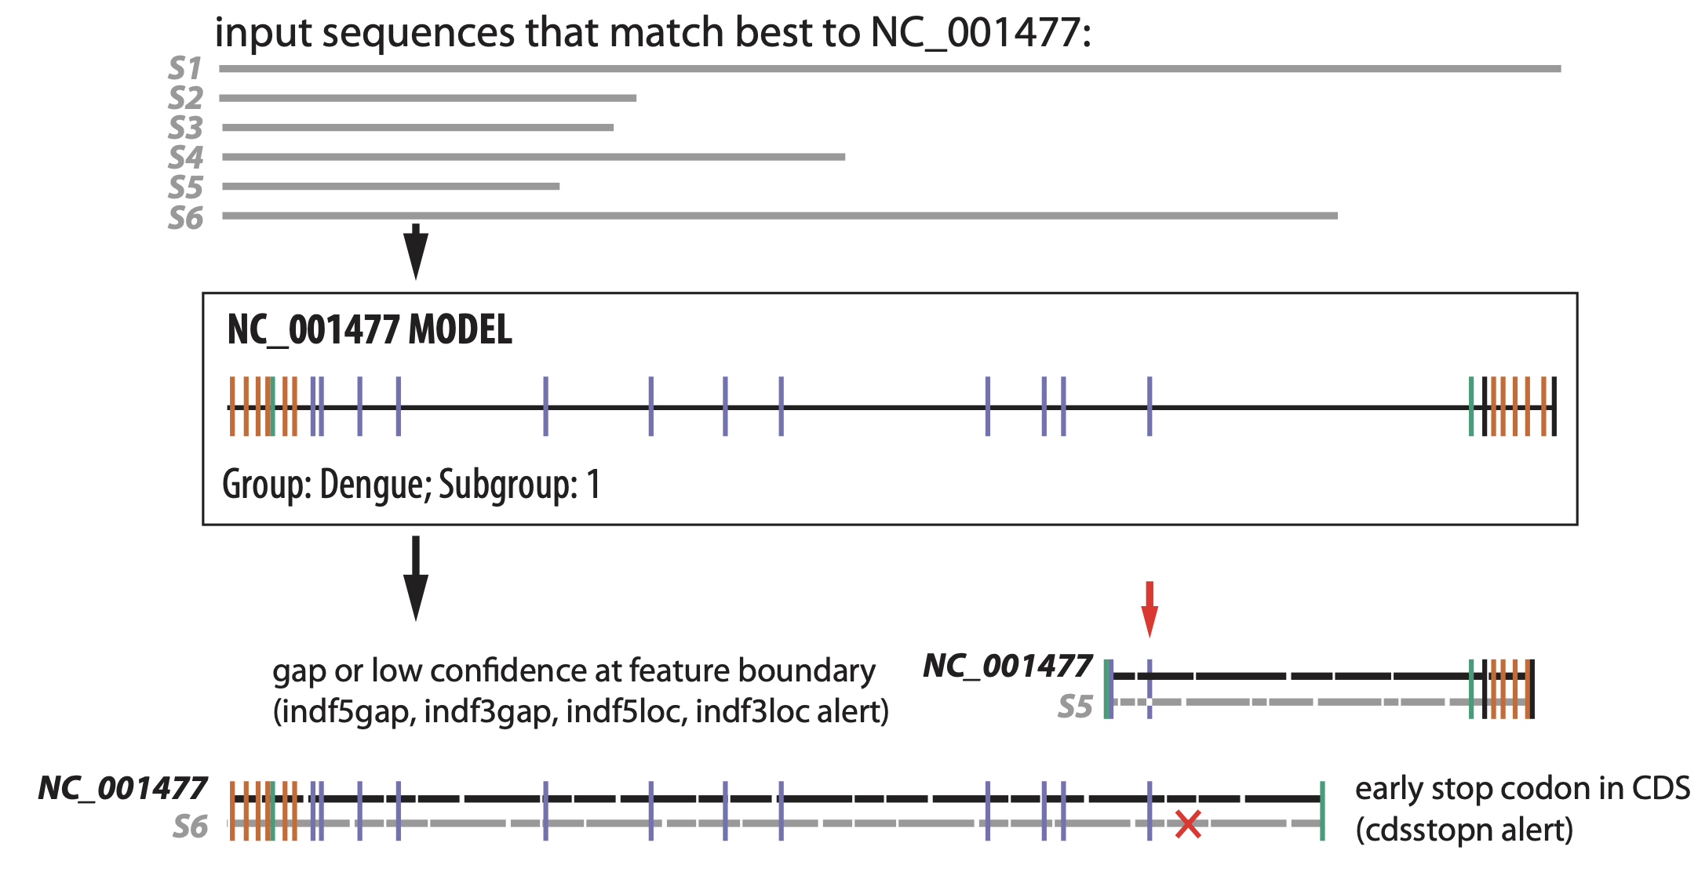
Stage 3: Alignment & feature mapping
Parsing the alignment allows new types of alerts to be detected

Slide 18
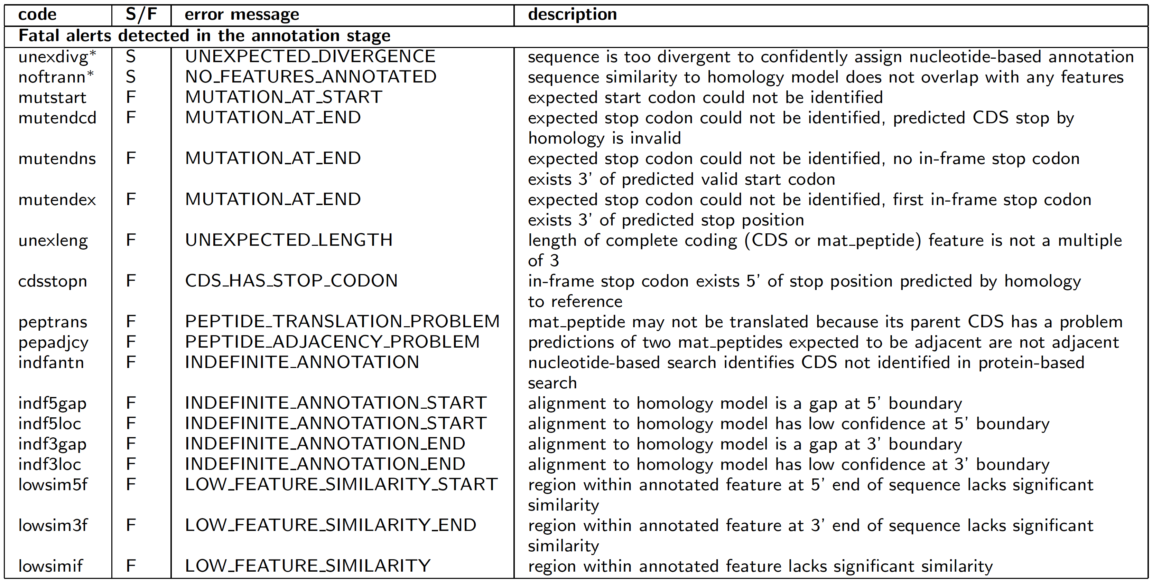
Alerts reported in alignment stage

Slide 19
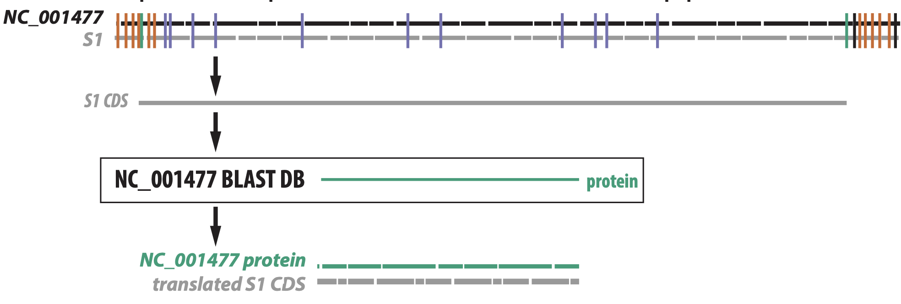
Stage 4: Protein validation (Alejandro Schaffer)
Compare each predicted CDS to model (RefSeq) proteins with BLASTX

Slide 20
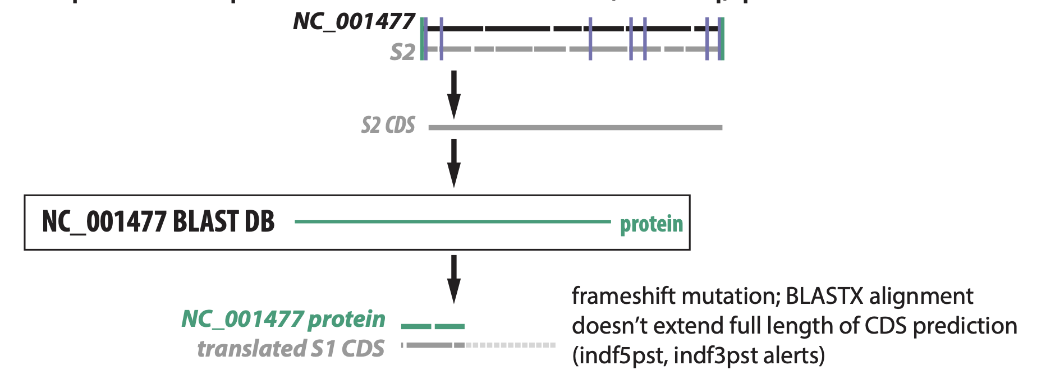
Stage 4: Protein validation (Alejandro Schaffer)
Compare each predicted CDS to model (RefSeq) proteins with BLASTX

Slide 21
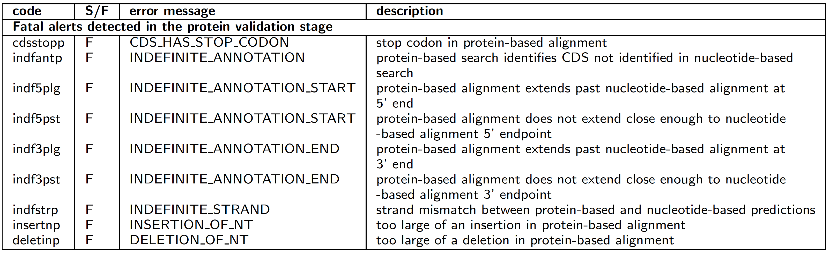
Alerts reported in protein validation stage

Slide 22
Enhancements for SARS-CoV-2 analysis
Acceleration based on a BLASTN alignment, reduces processing time from several minutes to 2s per typical sequence
Replacement of stretches of Ns with 'expected' nucleotides from the RefSeq when possible
virus | % of nucleotides that are Ns | % of seqs w/stretch of Ns >= 50 nt | number of sequences
SARS-CoV-2 | 1.12% | 26.4% | 28,936
Norovirus | 0.296% | 0.628% | 43,937
Dengue virus | 0.0037% | 0.0070% | 101,701

Slide 23
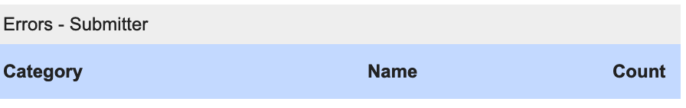
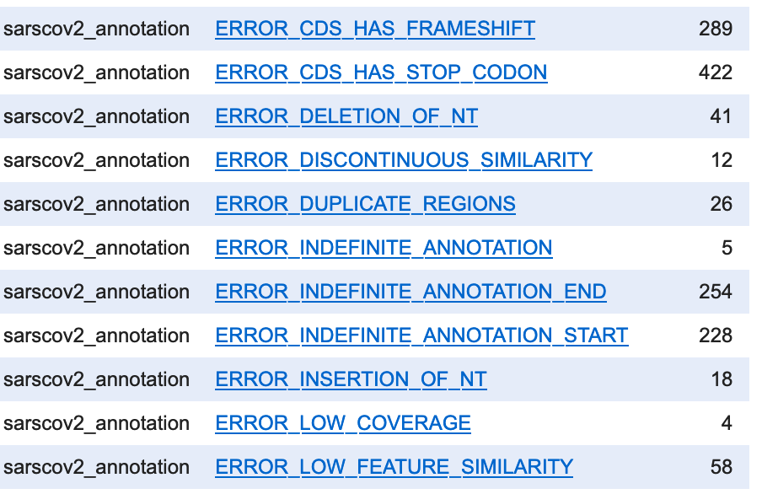
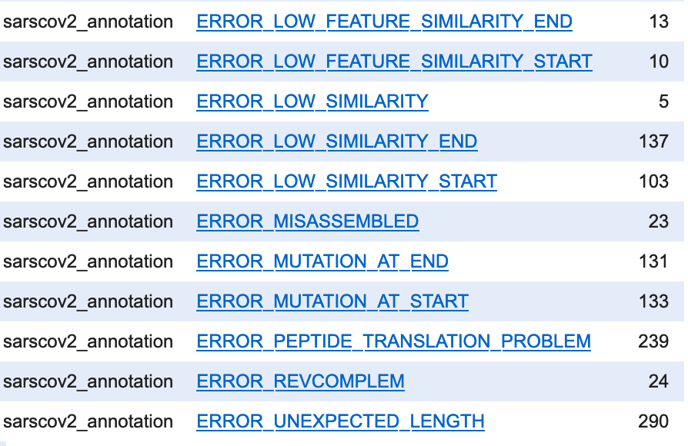
Fatal alert counts - SARS-CoV-2

Slide 24
Example of SARS-CoV-2 failure that was trimmed by indexer
ExampleSeq1 – FAILed due to DUPLICATE_REGIONS, LOW_SIMILARITY_START and LOW_SIMILARITY
alert alert
desc detail
-------------------- ------
DUPLICATE_REGIONS similarity to a model region occurs more than once [15307-15350 (len 44 >= 20) hits
1 and 2 (model:2..29876,15307..15350 seq:25..29899,29938..29981)]
LOW_SIMILARITY_START significant similarity not detected at 5' end of the sequence [low similarity region of
length 24 (1..24)]
LOW_SIMILARITY internal region without significant similarity [low similarity region of length 38
(29900..29937)]

Slide 25
Example of SARS-CoV-2 failure that was trimmed by indexer
ExampleSeq1 – FAILed due to DUPLICATE_REGIONS, LOW_SIMILARITY_START and LOW_SIMILARITY
nearly identical to NC_045512.1 27697..27719 (off by a single U)
5' end: vvvv vvvvvvvvvvvvvvvvv
ExampleSeq1 caaga-acuuacucuccaauuuuucUUAAAGGUUUAUACCUUCCCAGGUA
#=GC RF .....A...................UUAAAGGUUUAUACCUUCCCAGGUA
Identical *************************
identical to NC_045512.1 15316..15350
3’ end: vvvvvvvvvvvvvvvvvvvvvvvvvvvvvvvvvvvv
ExampleSeq1 AGAAUGACAAUAAGGUAGCGAAAUUCCUUGUCAACUAAUUAuugaccugcacgaaaggcgcaugccuaacaugcuuagaauuauggccucacuugu
#=GC RF AGAAUGACAAAAAAAAAAAAAAAAAAAAAAAAAAAAAAAAA.......................................................
Identical ********** ** * *** ** ** *

Slide 26
Example of SARS-CoV-2 failure that was eventually accepted
ExampleSeq2 – FAILed due to CDS_HAS_STOP_CODON, submitter verified
#alert alert
#desc detail
#----------------- ------
CDS_HAS_STOP_CODON in-frame stop codon exists 5' of stop position predicted by
homology to reference, revised to 27893..27916 (stop shifted 342 nt)
CDS_HAS_STOP_CODON stop codon in protein-based alignment [stop codon(s) end at
position(s) 27916]

Slide 27
Example of SARS-CoV-2 failure that was eventually accepted
ExampleSeq2 – FAILed due to CDS_HAS_STOP_CODON, submitter verified
CDS_HAS_STOP_CODON: ORF8 stop shifts by 342nt
27916
v
ExampleSeq2 [27893...ACATGAAATTTCTTGTTTTCTTATGAATCATCACAACTGTAGCTGCATTTCACC...28258]
NC_045512 [27894...ACATGAAATTTCTTGTTTTCTTAGGAATCATCACAACTGTAGCTGCATTTCACC...28259]
identical *********************** ******************************

Slide 28
Limitations
Makes inferences in nucleotide space, not protein space
Model (RefSeq) must be representative
Divergent sequences, novel stop codons, etc. are problematic
Requires 64Gb of RAM (!) for some SARS-CoV-2 sequences

Slide 29
Important features of VADR
Try it out! Review your sequences before submission
PASS/FAIL decision for each sequence with
informative alert messages
User control over fatal/non-fatal alerts and thresholds
Standalone version for submitters and other users
General tool applicable to any virus (but performance is dependent on sequence diversity)
Features can be as short as a single nucleotide, and potentially multiple 'segments' (programmed frameshifts)

Slide 30
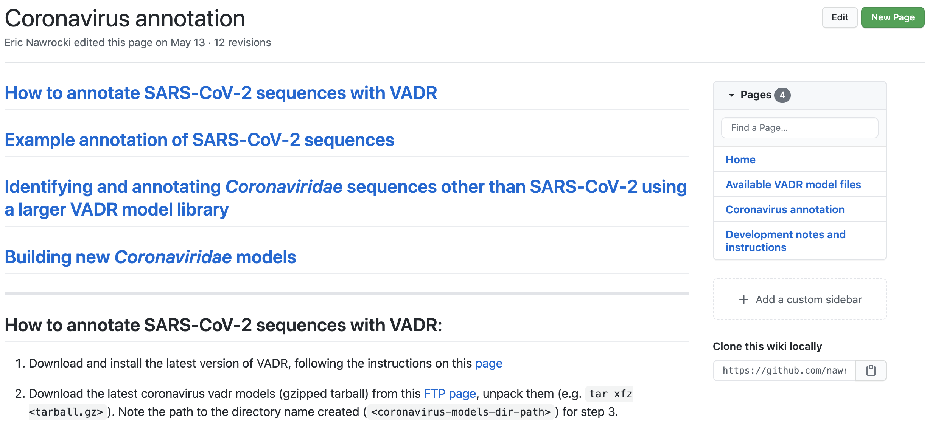
Get VADR documentation on GitHub
https://github.com/nawrockie/vadr/wiki/Coronavirus-annotation
Notes:
https://github.com/nawrockie/vadr/wiki/Coronavirus-annotation

Slide 31
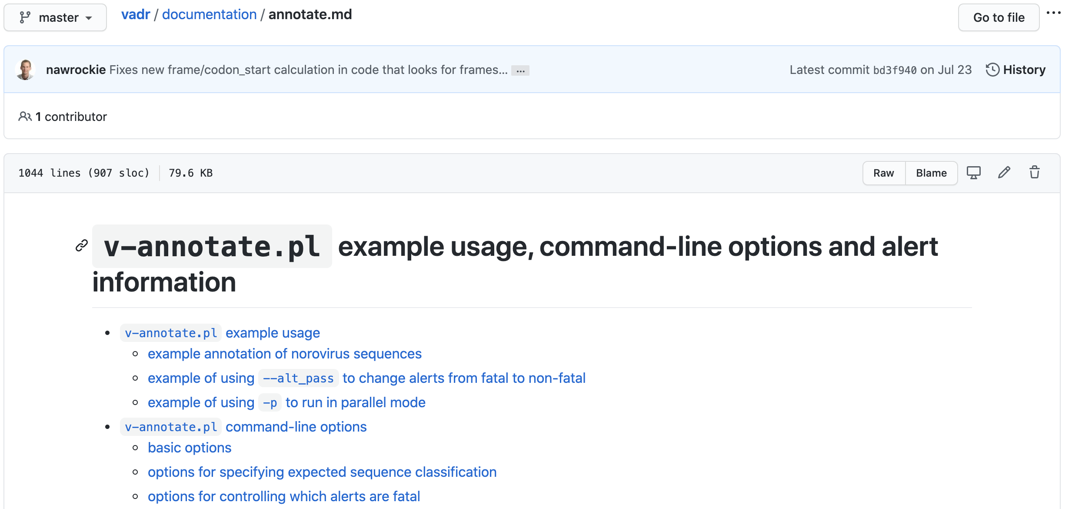
GitHub documentation (cont.)
https://github.com/nawrockie/vadr/wiki/Coronavirus-annotation
Notes:
https://github.com/nawrockie/vadr/wiki/Coronavirus-annotation

Slide 32
What VADR means for submissions
Speed - automating annotation saves time for submitter and results in faster data release
Quality control - VADR checks for sequence variability in coding and non-coding regions
Consistency - standard nomenclature for genes and products allows for easier retrieval and comparisons
Value Added - annotation of mature peptides and RNA structural components

Slide 33
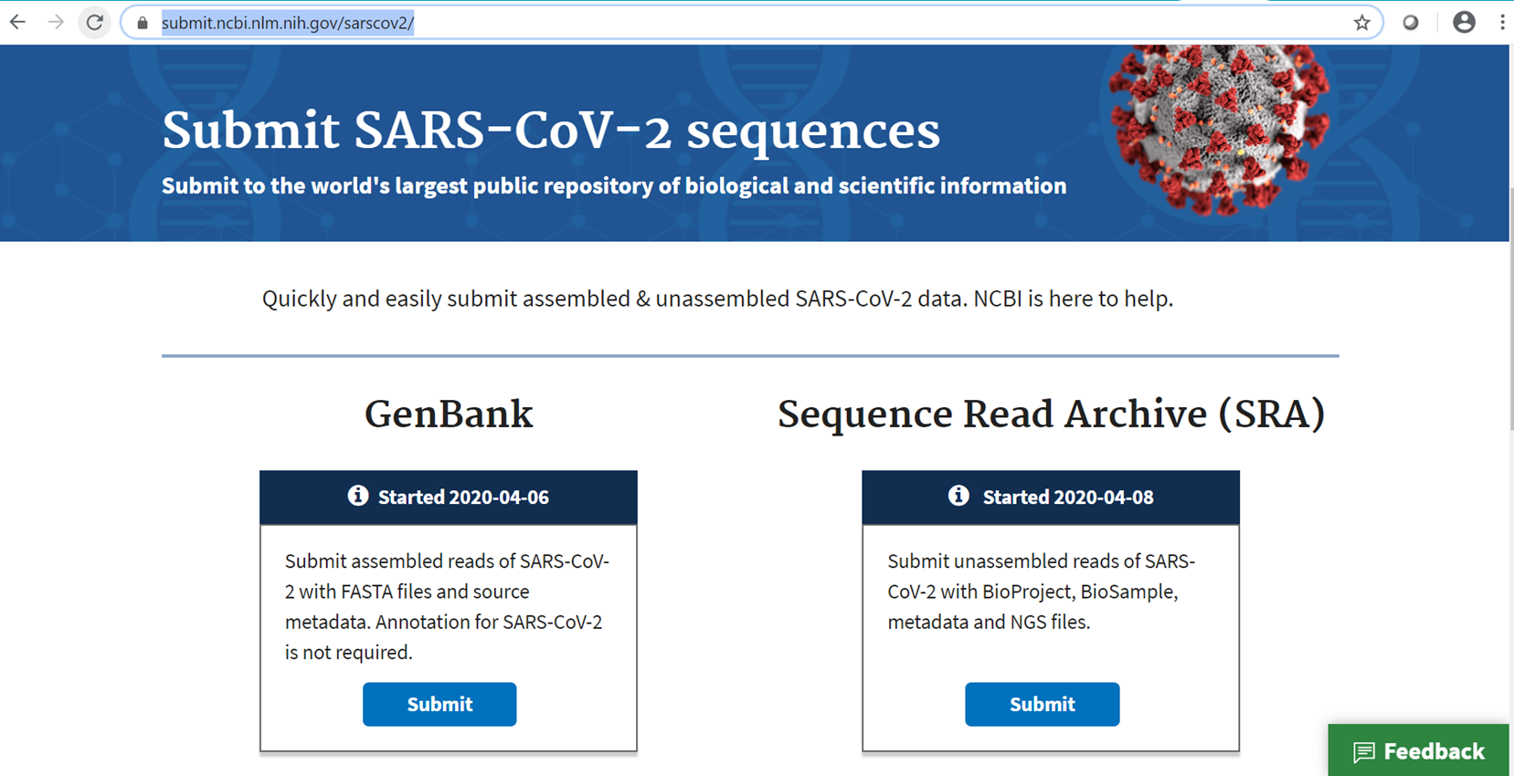
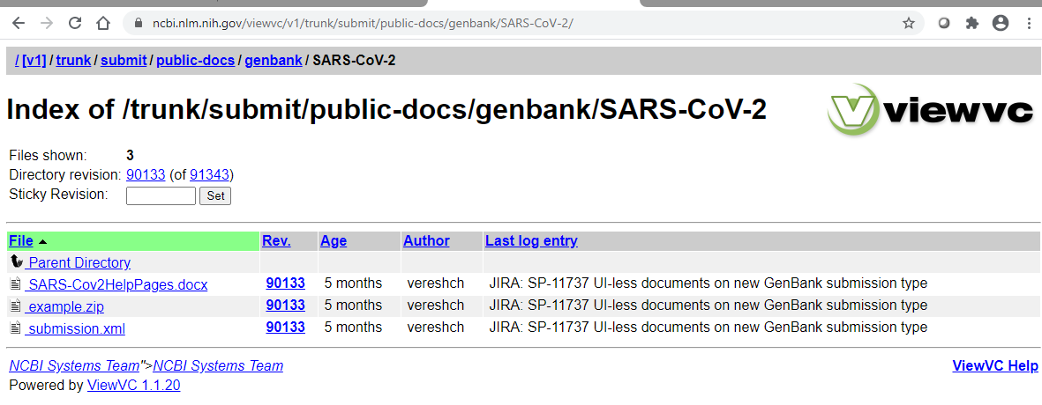
Submitting assembled sequences
Submit on the web
Submit programmatically
Common requirements: FASTA, source table, submitter information
Both accept BioProject, BioSample and SRA run accession in source table
Common reporting system: VADR, validator, discrepancy report

Slide 34
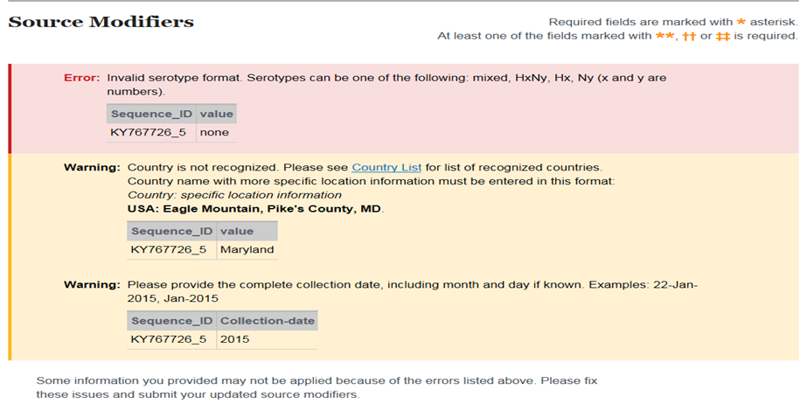
Web submission to GenBank
Forms prompt for required information
Source information imported as table or use of editable table
Interactive source and sequence validation
Country, date, isolate format
Sequence length and vector screening

Slide 35
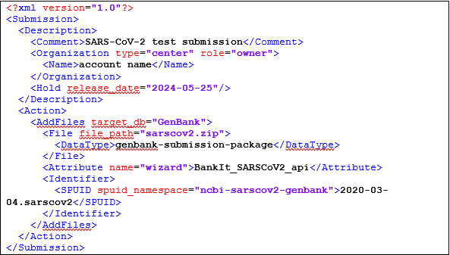
Programmatic submissions
.zip archive file and submission .xml file uploaded via ftp
.fsa, .src, .sbt, optional .cmt
Sequence checks: low quality, vector, length. Source checks: Country, date, isolate format
If no formatting errors, a temporary SUB number is assigned in report.xml
VADR validation
Accessions, files on Submission Portal: https://submit.ncbi.nlm.nih.gov/subs/api/
Notes:
https://www.ncbi.nlm.nih.gov/viewvc/v1/trunk/submit/public-docs/genbank/SARS-CoV-2/SARS-Cov2HelpPages.docx?view=log

Slide 36
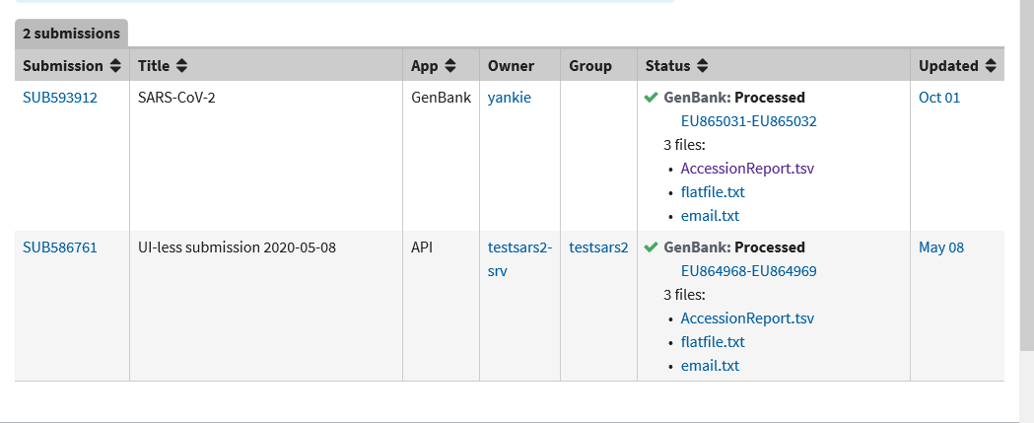
Common accession reports

Slide 37
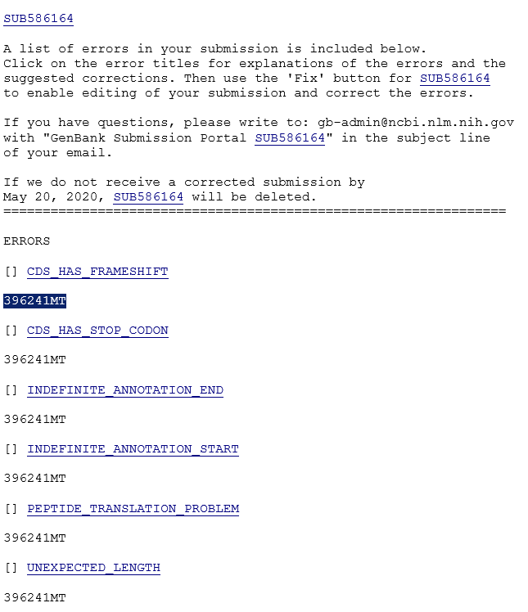
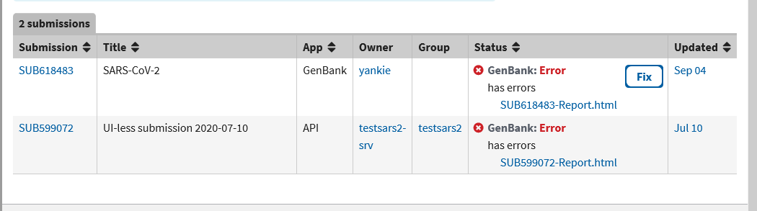
Common VADR alert reporting

Slide 38
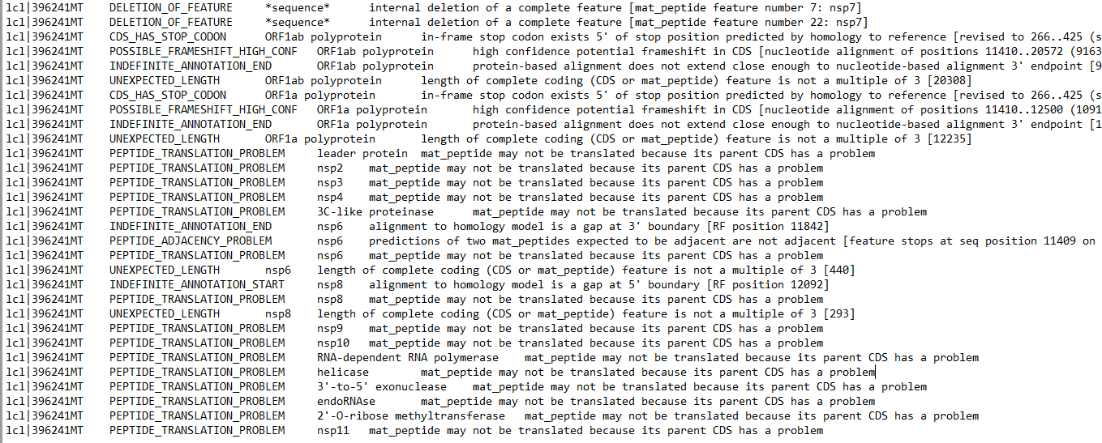
Future improvements
Validator changes for handling Ns will result in less manual review
Include detailed error report as separate file

Slide 39
VADR alerts on confirmed mutations
Write gb-admin@ncbi.nlm.nih.gov
Read coverage over area of mutation
SRR number if not already included
If mutation is common, please let us know!
We can add additional sequences to VADR reference set so future submissions with the same mutation will not produce an alert
Submitter-confirmed mutations in ORF7a, ORF7b, ORF8, ORF3a, ORF6, ORF10 and S

Slide 40
Create data connections ←→
Do you submit to GenBank and SRA?
BioProject can be used to link your submissions!
NCBI-created SPHERES umbrella = PRJNA615625
New BioProject submissions: Enter this accession # as you submit
Already submitted? Email us at submit-help@ncbi.nlm.nih.gov & we’ll make the connection
Use the same BioSample in both your SRA and GenBank submissions

Slide 41
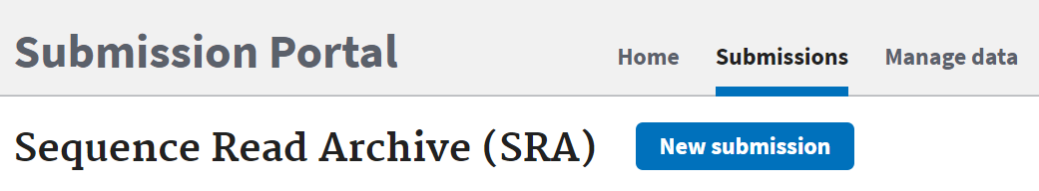
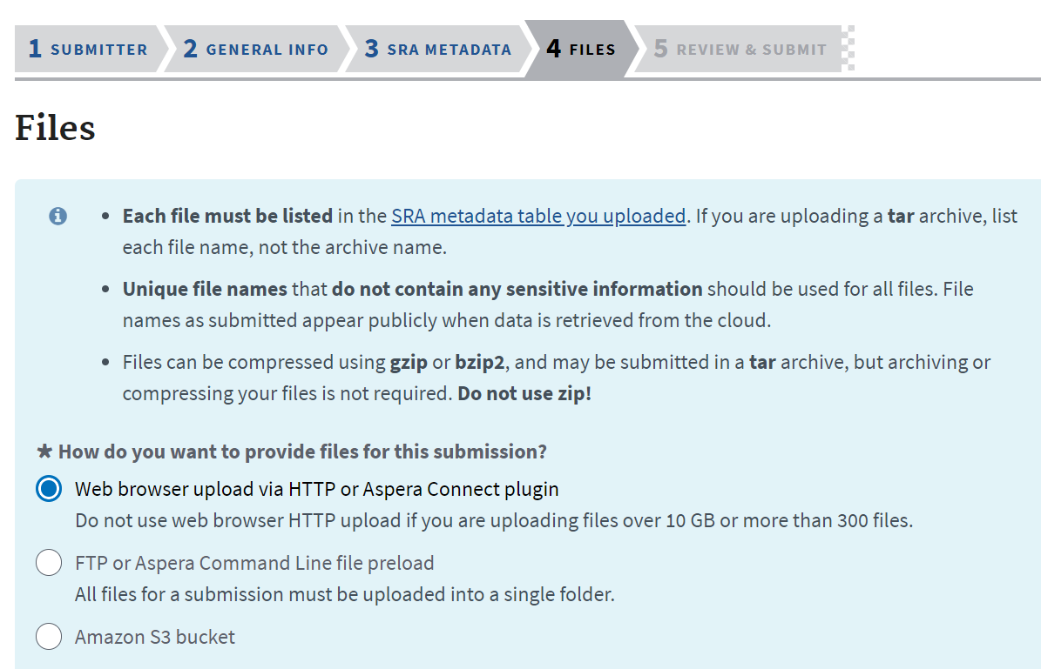
Getting started with SRA submission
Submit unassembled reads to SRA
Register BioProject & BioSample during SRA submission
Flexible file upload options
Web or FTP
Cloud-based: AWS now, GCP next month

Slide 42
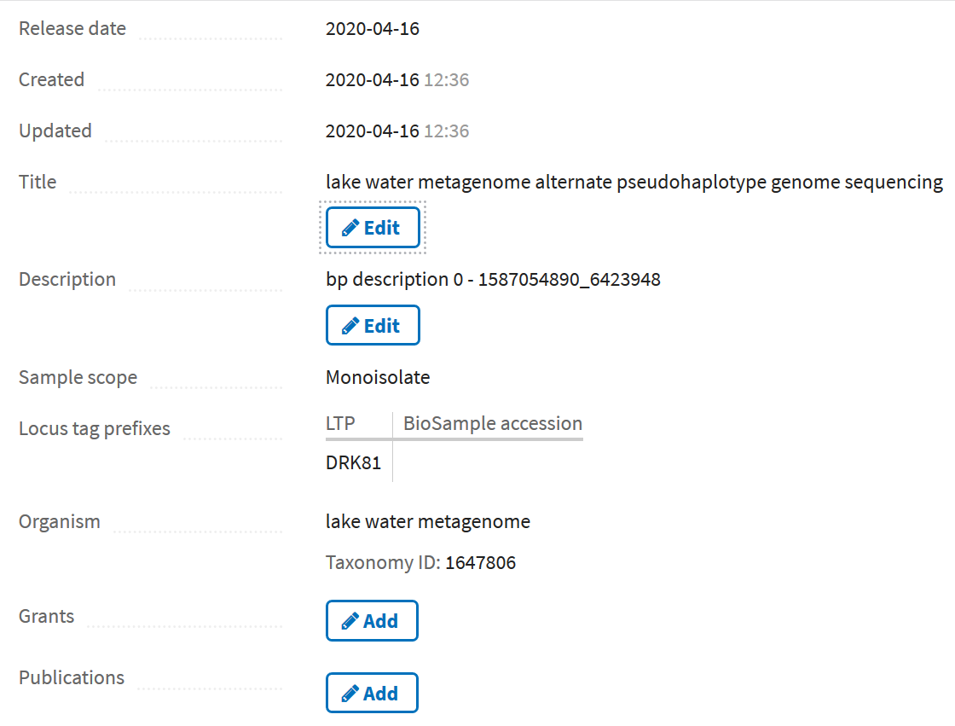
More on SRA submission & stats
Modify submission after processing
Edit or add BioProject and SRA metadata
"Release now" or delay release
Programmatic submission option also available
SARS-CoV-2 SRA data: 11K Runs from USA and ~100K global
Data now on https://registry.opendata.aws/ncbi-covid-19/ !
dataview.ncbi.nlm.nih.gov

Slide 43

We’re here for you!
Enhancements made per SPHERES input
Programmatic submission option(s)
File upload drag-and-drop
Help documentation edits
Parking lot – Input needed!
BioSample linkage & data flow during GenBank submission
Combined SRA & GenBank programmatic submission
“Human scrubber” tool for removing human sequences
Taking volunteers for testing, feedback!

Slide 44

Q&A
This Photo by Unnown author is licensed under CC BY-NC.

Slide 45
Help
NCBI is here to help with your submission!
GenBank gb-admin@ncbi.nlm.nih.gov
SRA sra@ncbi.nlm.nih.gov
VADR resources on GitHub https://github.com/nawrockie/vadr
RefSeq
Send feedback on RefSeq NC_045512 to Eneida.Hatcher@nih.gov

